Slide 1

CS 7081 Advanced Algorithms
Final Project
Team 01
Christopher Broderick,
Rohit Dureja,
Akash Mohapatra,
Bill Nicholson,
Asrith Singa Reddy.
[1]

Slide 2
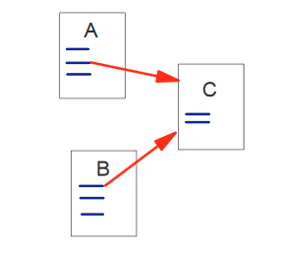
Page Rank
[2]

Slide 3
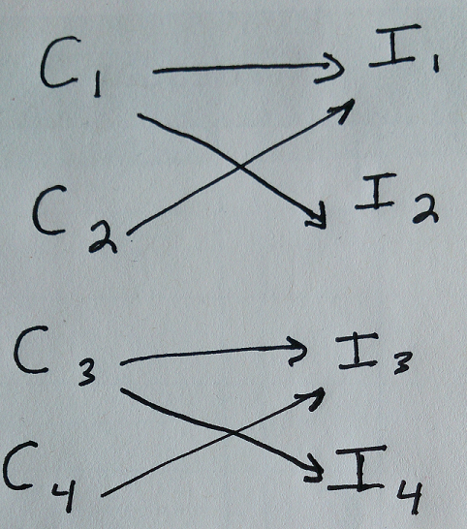
Clients Purchase Items: those edges are easy
Bipartite graph.
Can’t get from I to C

Slide 4

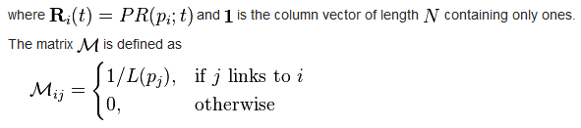
Compute the ranking vector

Slide 5
Add edges to get from Items to Clients

Slide 6
Results
4 items to be processed.
4 clients to be processed.
0.000 0.000 0.000 0.000 0.533 0.067 0.476 0.095
0.000 0.000 0.000 0.000 0.267 0.133 0.238 0.190
0.000 0.000 0.000 0.000 0.133 0.267 0.190 0.238
0.000 0.000 0.000 0.000 0.067 0.533 0.095 0.476
0.381 0.267 0.133 0.048 0.000 0.000 0.000 0.000
0.048 0.133 0.267 0.381 0.000 0.000 0.000 0.000
0.476 0.333 0.267 0.095 0.000 0.000 0.000 0.000
0.095 0.267 0.333 0.476 0.000 0.000 0.000 0.000
Initial state of Ranking vector:
0.12500
0.12500
0.12500
0.12500
0.12500
0.12500
0.12500
0.12500
Final state of Ranking vector:
0.14278
0.10722
0.10722
0.14278
0.10722
0.10722
0.14278
0.14278

Slide 7
The Computed Transition Matrix
 | I1 | I2 | I3 | I4 | C1 | C2 | C3 | C4
I1 | 0 | 0 | 0 | 0 | 0.533 | 0.067 | 0.476 | 0.095
I2 | 0 | 0 | 0 | 0 | 0.267 | 0.133 | 0.238 | 0.19
I3 | 0 | 0 | 0 | 0 | 0.133 | 0.267 | 0.19 | 0.238
I4 | 0 | 0 | 0 | 0 | 0.067 | 0.533 | 0.095 | 0.476
C1 | 0.381 | 0.267 | 0.133 | 0.048 | 0 | 0 | 0 | 0
C2 | 0.048 | 0.133 | 0.267 | 0.381 | 0 | 0 | 0 | 0
C3 | 0.476 | 0.333 | 0.267 | 0.095 | 0 | 0 | 0 | 0
C4 | 0.095 | 0.267 | 0.333 | 0.476 | 0 | 0 | 0 | 0

Slide 8
References
[1] Search.Dilbert.com
[2] Page, Lawrence, et al. "The PageRank citation ranking: bringing order to the web." (1999).
[3] http://www.ams.org/samplings/feature-column/fcarc-pagerank
[4] https://en.wikipedia.org/wiki/PageRank

